Slide 1
Regularization

Slide 2
What We’ll Cover
Regularization
What is it?
Why?
Types
Model generalization error sources

Slide 3

What is regularization?
An extra term we add to our cost function
Let’s us modify the way our algorithm learns from mistakes and performs optimization
Notes:
Photo: https://www.flickr.com/photos/107442568@N08/12547327134

Slide 4
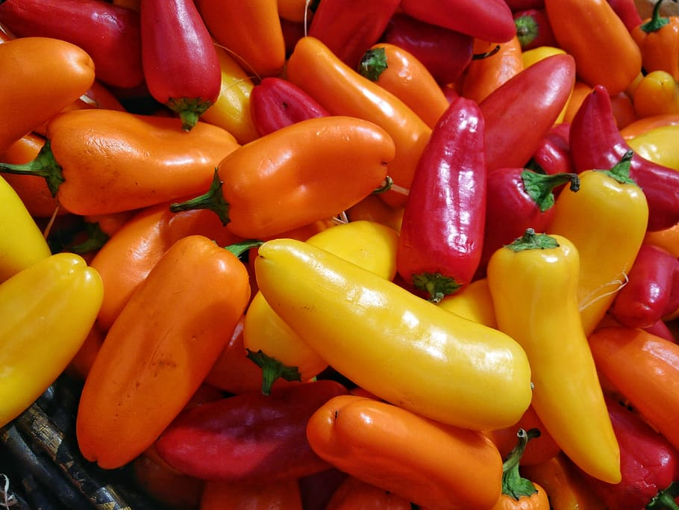
Why use regularization?
Helps us control overfitting
Helps control the growth and importance of specific components
Lets us modify and control how our algorithm learns
Notes:
Photo: https://p0.piqsels.com/preview/75/886/497/4480j35547m45663a3pm5fmsvd.jpg

Slide 5
Types of regularization
L2
L1
Elastic net
Notes:
Photo: https://p0.piqsels.com/preview/75/886/497/4480j35547m45663a3pm5fmsvd.jpg

Slide 6
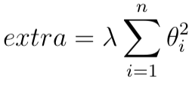
Types of regularization
L2
Add on square of weights into cost function (not including bias, i=0)
L1
Elastic net
Notes:
Photo: https://p0.piqsels.com/preview/75/886/497/4480j35547m45663a3pm5fmsvd.jpg

Slide 7
Types of regularization
L2
Add on square of weights into cost function (not including bias, i=0)
Lambda (alpha) is a hyperparameter that controls amount of regularization
L1
Elastic net
Notes:
Photo: https://p0.piqsels.com/preview/75/886/497/4480j35547m45663a3pm5fmsvd.jpg

Slide 8
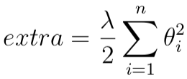
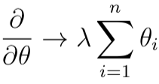
Types of regularization
L2
Add on square of weights into cost function (not including bias, i=0)
Lambda (alpha) is a hyperparameter that controls amount of regularization
Since lambda is free, we can also use lambda/2 for better differential
L1
Elastic net
Notes:
Photo: https://p0.piqsels.com/preview/75/886/497/4480j35547m45663a3pm5fmsvd.jpg

Slide 9
Types of regularization
L2
Add on square of weights into cost function (not including bias, i=0)
Lambda (alpha) is a hyperparameter that controls amount of regularization
Since lambda is free, we can also use lambda/2 for better differential
Squashes large parameters to not have some parameters influence be too large
L1
Elastic net
Notes:
Photo: https://p0.piqsels.com/preview/75/886/497/4480j35547m45663a3pm5fmsvd.jpg

Slide 10
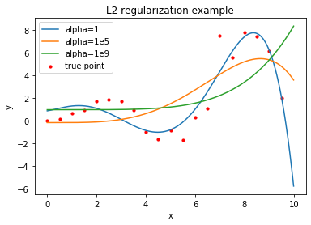
Types of regularization
L2
Add on square of weights into cost function (not including bias, i=0)
Lambda (alpha) is a hyperparameter that controls amount of regularization
Since lambda is free, we can also use lambda/2 for better differential
Squashes large parameters to not have some parameters influence be too large
L1
Elastic net
Notes:
Photo: https://p0.piqsels.com/preview/75/886/497/4480j35547m45663a3pm5fmsvd.jpg

Slide 11
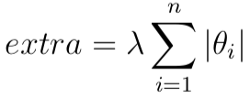
Types of regularization
L2
L1
Add on absolute value of feature weights
Elastic net
Notes:
Photo: https://p0.piqsels.com/preview/75/886/497/4480j35547m45663a3pm5fmsvd.jpg

Slide 12
Types of regularization
L2
L1
Add on absolute value of feature weights
Again, lambda is hyperparameter to control regularization
Elastic net
Notes:
Photo: https://p0.piqsels.com/preview/75/886/497/4480j35547m45663a3pm5fmsvd.jpg

Slide 13
Types of regularization
L2
L1
Add on absolute value of feature weights
Again, lambda is hyperparameter to control regularization
Acts like feature selection, pushing some weights to 0
Elastic net
Notes:
Photo: https://p0.piqsels.com/preview/75/886/497/4480j35547m45663a3pm5fmsvd.jpg

Slide 14
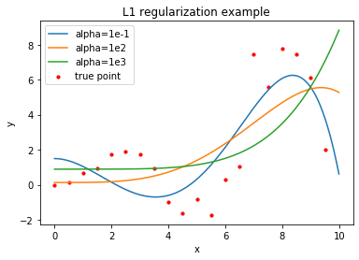
Types of regularization
L2
L1
Add on absolute value of feature weights
Again, lambda is hyperparameter to control regularization
Acts like feature selection, pushing some weights to 0
Elastic net
Notes:
Photo: https://p0.piqsels.com/preview/75/886/497/4480j35547m45663a3pm5fmsvd.jpg

Slide 15
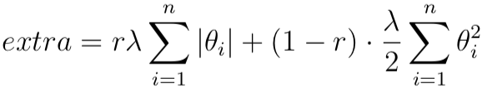
Types of regularization
L2
L1
Elastic net
Mix of L1 and L2
r between 0 and 1, defines mixing
Lambda defines strength of regularization
Notes:
Photo: https://p0.piqsels.com/preview/75/886/497/4480j35547m45663a3pm5fmsvd.jpg

Slide 16
Types of regularization
L2
L1
Elastic net
Mix of L1 and L2
r between 0 and 1, defines mixing
Lambda defines strength of regularization
Note: Sometimes you will see “C”, which is just the inverse of lambda
Notes:
Photo: https://p0.piqsels.com/preview/75/886/497/4480j35547m45663a3pm5fmsvd.jpg

Slide 17
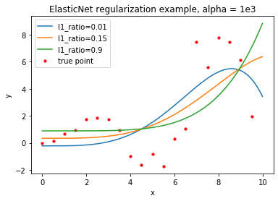
Types of regularization
L2
L1
Elastic net
Mix of L1 and L2
r between 0 and 1, defines mixing
Lambda defines strength of regularization
Note: Sometimes you will see “C”, which is just the inverse of lambda
Notes:
Photo: https://p0.piqsels.com/preview/75/886/497/4480j35547m45663a3pm5fmsvd.jpg

Slide 18
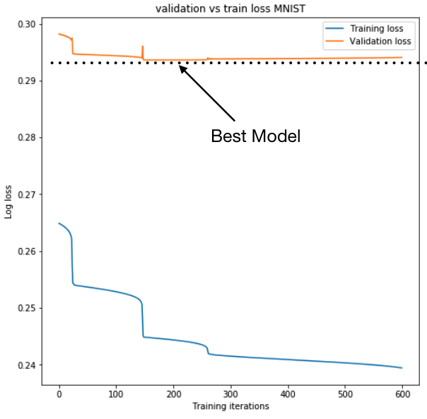
Types of regularization
Early stopping
Does not modify cost function
Training stops when training and validating accuracy start diverging
Take model at point with lowest validation error
Notes:
Photo: https://p0.piqsels.com/preview/75/886/497/4480j35547m45663a3pm5fmsvd.jpg

Slide 19
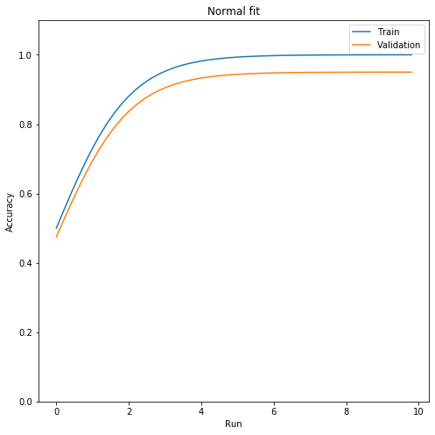
Model Generalization Error Sources
Overfitting
Underfitting
Irreducible error
Bias
Variance
Notes:
Photo: https://p0.piqsels.com/preview/75/886/497/4480j35547m45663a3pm5fmsvd.jpg

Slide 20
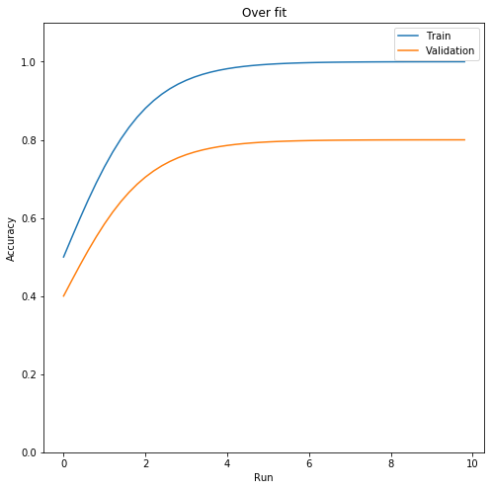
Model Generalization Error Sources
Overfitting
Model learns patterns in training data that don’t generalize.
Underfitting
Irreducible error
Bias
Variance
Notes:
Photo: https://p0.piqsels.com/preview/75/886/497/4480j35547m45663a3pm5fmsvd.jpg

Slide 21
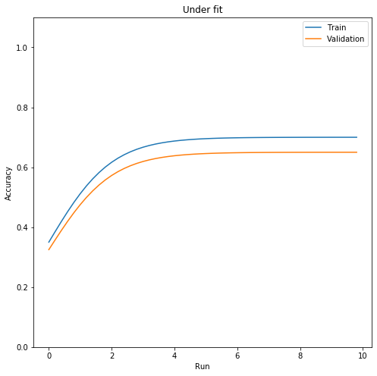
Model Generalization Error Sources
Overfitting
Underfitting
Model doesn’t learn enough from training data and doesn’t fully extract the underlying structure of the data
Irreducible error
Bias
Variance
Notes:
Photo: https://p0.piqsels.com/preview/75/886/497/4480j35547m45663a3pm5fmsvd.jpg

Slide 22
Model Generalization Error Sources
Overfitting
Underfitting
Irreducible error
Natural variations in data or contributions from noise
Bias
Variance
Notes:
Photo: https://p0.piqsels.com/preview/75/886/497/4480j35547m45663a3pm5fmsvd.jpg

Slide 23
Model Generalization Error Sources
Overfitting
Underfitting
Irreducible error
Bias
Generalization errors due to wrong assumptions, e.g. assumed linear vs actual polynomial, usually leads to underfitting
Variance
Notes:
Photo: https://p0.piqsels.com/preview/75/886/497/4480j35547m45663a3pm5fmsvd.jpg

Slide 24
Model Generalization Error Sources
Overfitting
Underfitting
Irreducible error
Bias
Variance
High sensitivity to small variations in training data. Leads to overfitting
Bias-Variance tradeoff
Notes:
Photo: https://p0.piqsels.com/preview/75/886/497/4480j35547m45663a3pm5fmsvd.jpg

